Slide 1

HOSPITAL MANAGEMENT
TEAM MEMBERS :-
R. Ramana (23245A3207)
G. Akash (23245A3202)
K. Sudheer (23245A3204)

Slide 2

ABSTRACT:-
Our project Hospital Management system includes registration of patients, storing their details into the system, and also booking their appointments with doctors .Our software has the facility to give a unique id for every patient and stores the details of every patient and the staff automatically. User can search availability of a doctor and the details of a patient using the id .The Hospital Management System can be entered using a username and password. It is accessible either by an administrator or receptionist. Only they can add data into the database. The data can be retrieved easily. The interface is very user-friendly. The data are well protected for personal use and makes the data processing very fast

Slide 3
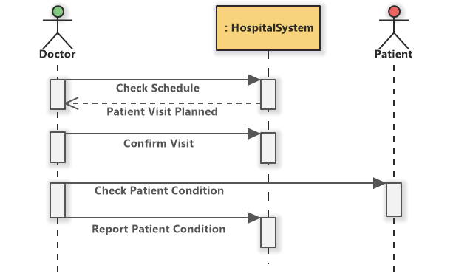
INTERACTIVE SLIDE

Slide 4
Existing System:-
Epic Systems Corporation
Cerner Corporation
McKesson Corporation
Allscripts Healthcare Solutions
Meditech

Slide 5
Proposed System:-
Enhanced User Experience
Comprehensive Patient Management
Dynamic Appointment Scheduling
Advanced Staff Administration
Integrated Telemedicine Support
Scalability and Interoperability
Data Security and Compliance

Slide 6
HARDWARE REQURIMENT:-
Intel i5 processor
Minimum 2gb ram
Atleast 500gb HDD
SOFTWARE REQURIMENT:-
Python Language
Operating System
Database
Web development (html, Css, Javascript, php)

Slide 7
ADVANTAGES :-
Easy to use because all Details of ambulance services will quickly available 24 x 7 on application
It can be easily accessed globally with help of Internet.
Maintaining records will be easier because all details are stored in database and retrieved easily from it.
Interactive and attractive design.
DISADVANTAGES :-
Internet connection
Security concern

Slide 8
Conclusion :-
In. conclusion, our Hospital Management System represents a significant advancement in
healthcare technology, offering a comprehensive solution to streamline hospital
operations, enhance patient care, and improve overall efficiency . By leveraging modern
technologies, robust architecture, and user-centered design principles, our HMS addresses
the evolving needs and challenges faced by healthcare institutions in today’s dynamic
healthcare landscape

Slide 9

THANK YOU :)

